Slide 1
Intro to Web Development
By Jeff Maxwell
TCN Solutions Inc.
jeff@tcnsolutions.com
www.jeffmaxwell.com
github.com/jeff-maxwell

Slide 2
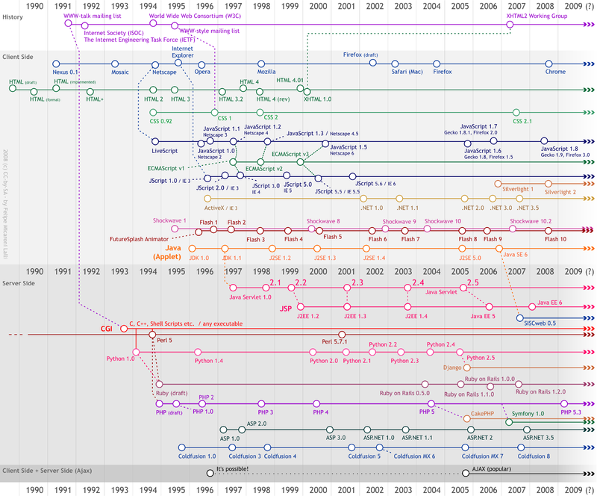
History

Slide 3
Client/Server
Web Browser
www.fccokc.com
Request www.fccokc.com
Response index.html
Request style.css
Response style.css
Request script.js
Response script.js
Request logo.png
index.html
style.css
script.js
logo.png
Response logo.png

Slide 4
HTML/CSS/JavaScript
HTML – HyperText Markup Language
<p>CONTENT</p>
CSS – Cascading Style Sheet
body { font-family: Arial, Helvetica, sans-serif; text-align: center; }
JavaScript (JS) – Client Side Programming Language NOTE: NOT related to the Java Language.
function showAlert() { alert("Hello Free Code Camp OKC!"); }

Slide 5
HTTP Codes
200 – OK
404 – Not Found
500 – Internal Server Error
http://http.cat

Slide 6
HTTP Verbs
POST - Create
GET - Read
PUT – Update/Replace
PATCH – Update/Modify
DELETE - Delete

Slide 7
Client Code (JavaScript)
JavaScript runs in the Browser
There are main frameworks/libraries built in JavaScript
Angular (Google)
React (Facebook)
Vue.js
Knockout
Ember
Seems like a new JavaScript framework is created everyday

Slide 8
Server Side
Code is executed on the server and returned to the client
Server side code can return
HTML/CSS/JavaScript
JSON – JavaScript Object Notation
XML
Files (Images, Video….)

Slide 9
Server Side Languages
C++
C
Java
C#
PHP
Ruby
Node.js (JavaScript)
Python
And a lot more.

Slide 10
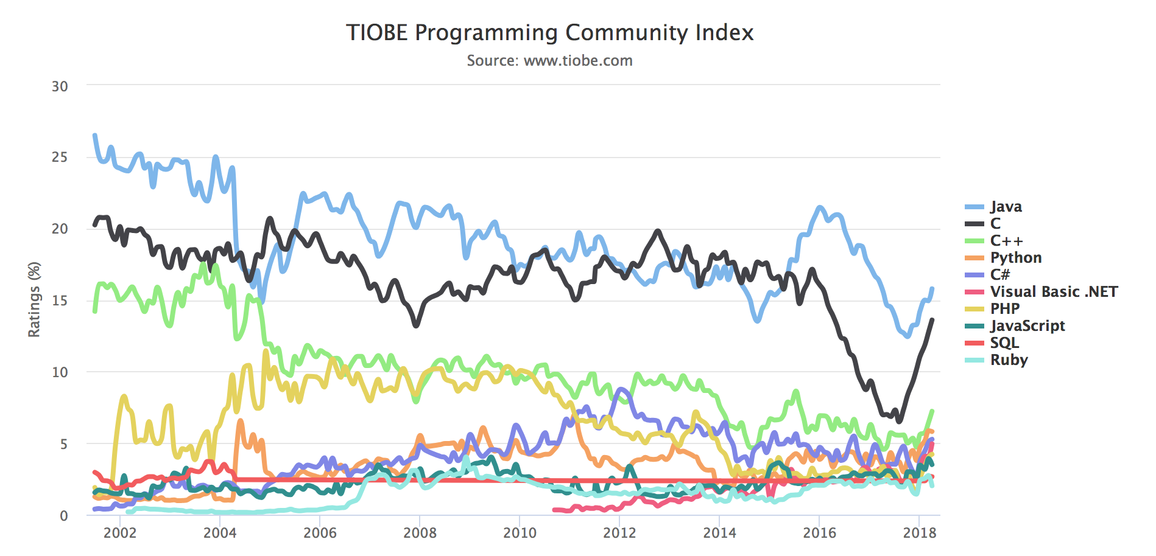
Server Code - Popularity

Slide 11
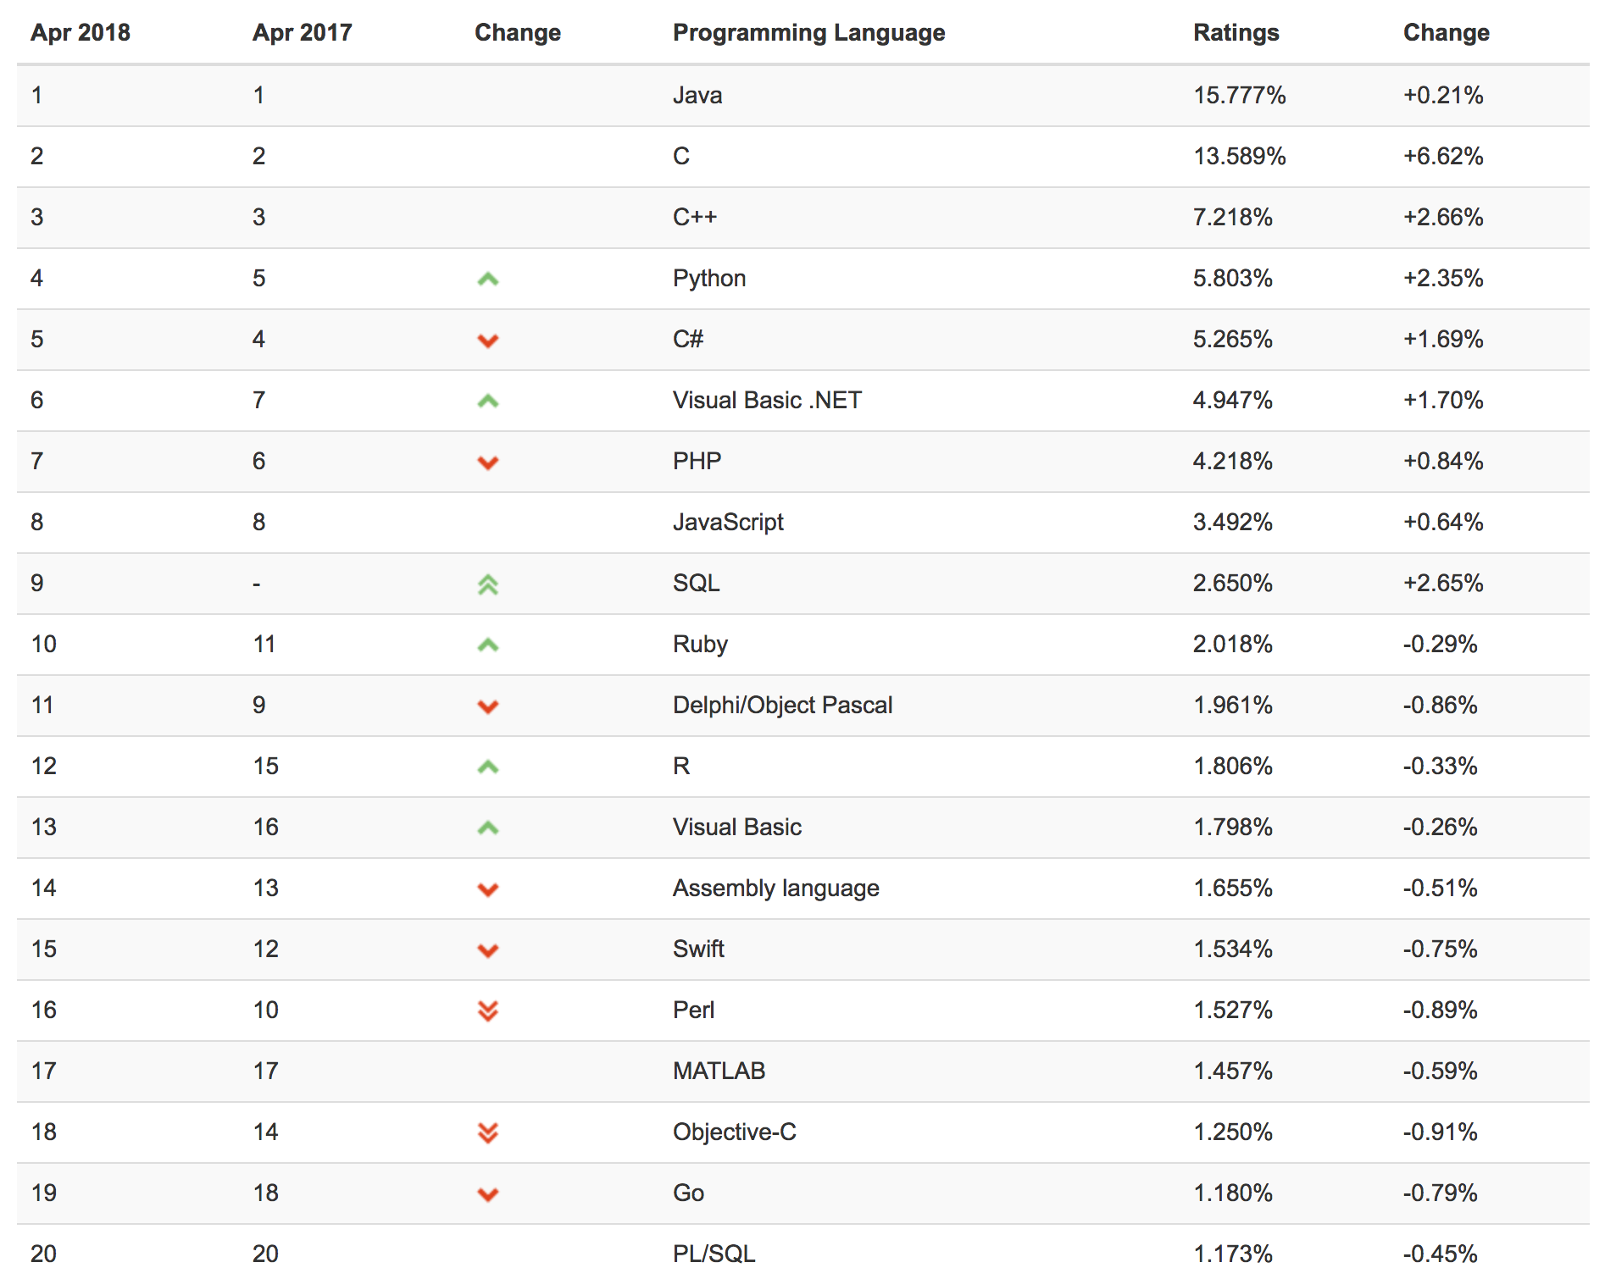
Server Code - Popularity

Slide 12
Local Market Needs
MEAN Stack – MongoDB, ExpressJS, Angular, Node.js
Angular
Some React
C#
Java

Slide 13
Learn the Coding Basics (Syntax)
Data Types
Integer, String, Boolean
Variables
Temporary Storage in Memory
Functions/Methods
function add(int a, int b) { return a+b; }
Loops
for (var x = 0; x < 10; x++)
while (x < 10)
….
Conditional Statements
if (x == 5)

Slide 14
Resources
www.freecodecamp.org
www.w3schools.com – HTML, CSS, JavaScript and more
www.w3.org – Official Documentation for HTML, CSS, JavaScript
ocw.mit.edu – MIT Open Courseware
online.stanford.edu – Stanford Online
www.codeacademy.com – Some FREE courses
mva.microsoft.com – HTML5 & CSS3 Fundamentals
udemy.com – Good classes for $10-$20/per class
pluralsight.com – A lot of courses for $29/month

Slide 15
Data Store

Slide 16
Security

Slide 17
Questions

Slide 18
Thank You
Jeff Maxwell
TCN Solutions Inc.
jeff@tcnsolutions.com
www.jeffmaxwell.com
github.com/jeff-maxwell

